Slide 1



Name: Md. Afridi Alom Pranto
ID No: 2102027
Reg No: 10154
Session: 2021-22
Level-II, Semester-II
Name: Mehedi Hasan
ID No: 2102007
Reg No: 10134
Session: 2021-22
Level-II, Semester-II
Name: Nazmus Sakib
ID No: 2102066
Reg No: 10193
Session: 2021-22
Level-II, Semester-II

Slide 2
Industry Type: Auto Rice Mill
Visited Industry Name: Kohinoor Auto Rice Limited
Location: House: Purbo Sharikkhali, Bashak Bazar, Upazila: Patuakhali Sadar, District: Patuakhali, Division: Barisal.
Number of Total Workers: 45

Slide 3
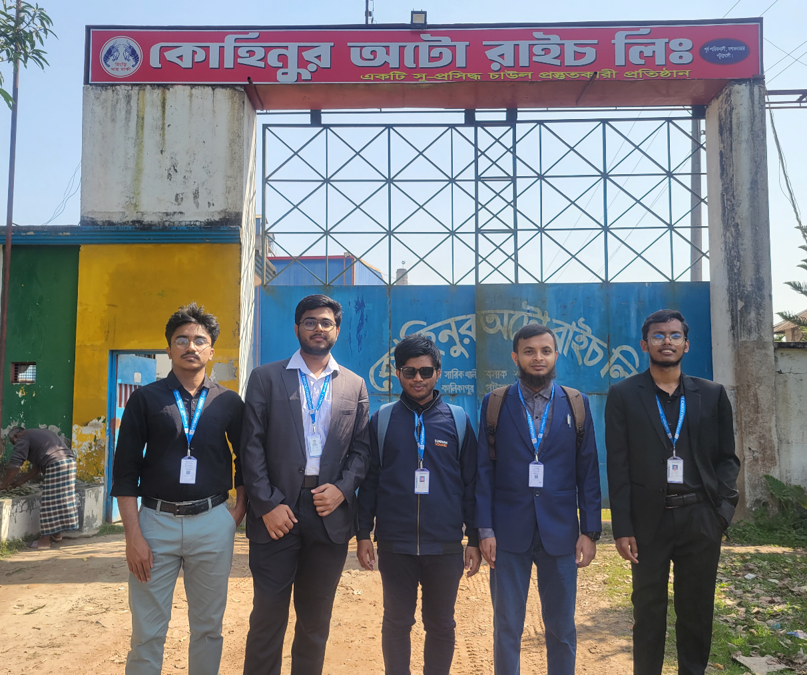
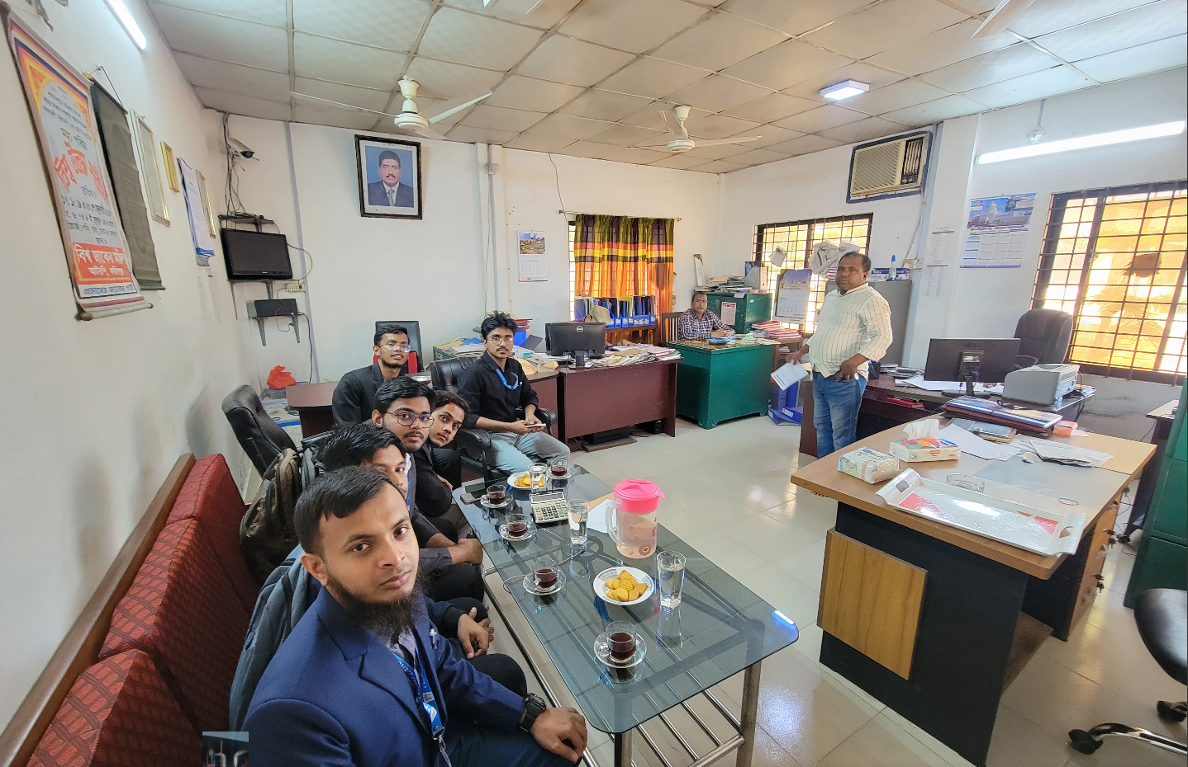

Slide 4
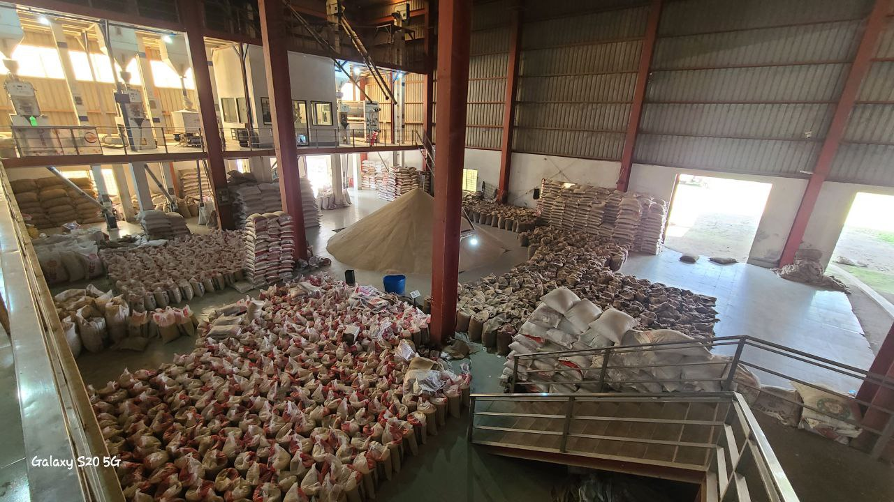
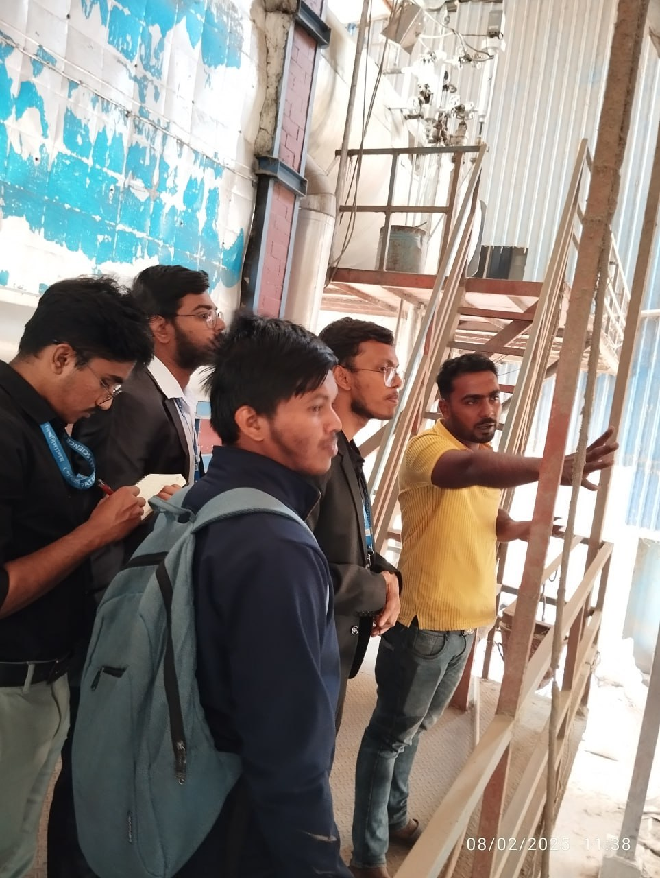
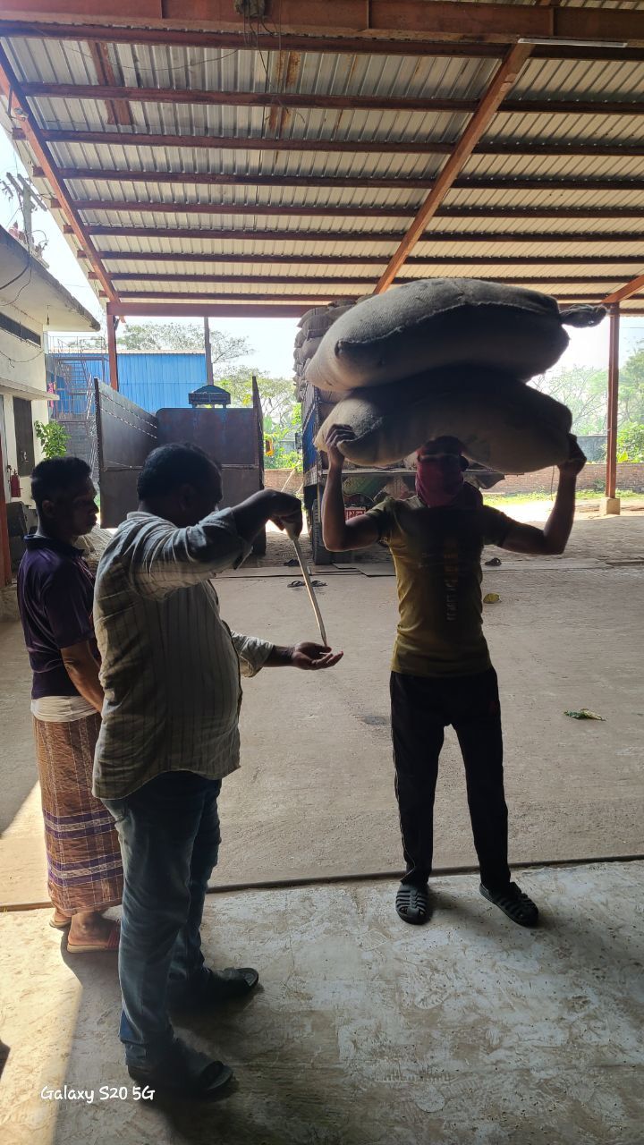
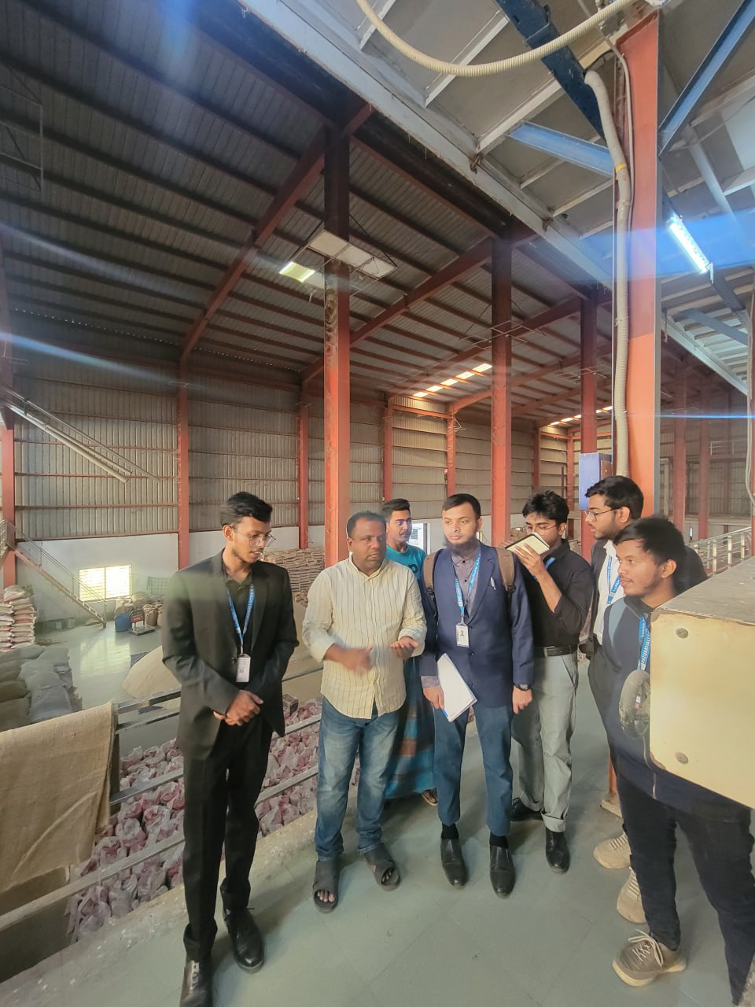
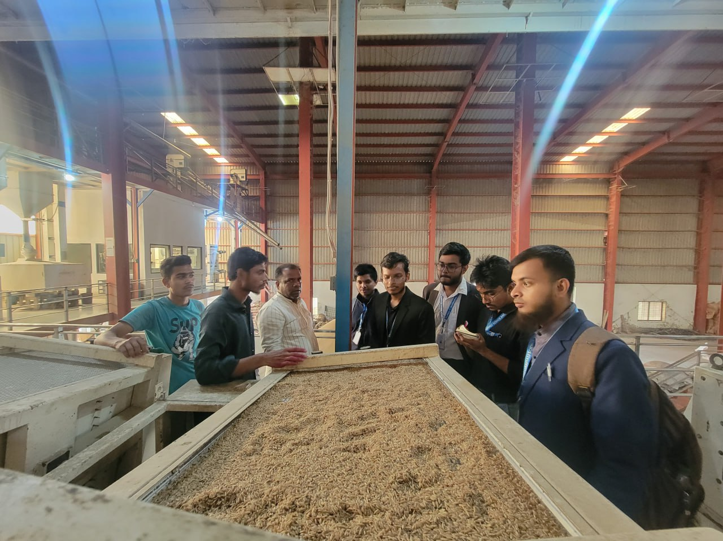

Slide 5
3. Problem Identification
Through interviews with staff and observation of current workflows, we identified the following key problems:
Manual Record Keeping: Inventory records are maintained on paper or in basic spreadsheets, leading to errors, duplication, and data loss.
Lack of Real-time Inventory Updates: There is no system to update inventory in real-time as rice is processed, packaged, or shipped.
Poor Traceability: Tracking of raw materials, processing batches, and final products is difficult due to disjointed records.
Inefficient Reporting: Generating reports for stock, production, and sales takes considerable time and often lacks accuracy.
No Centralized System: Data is siloed across departments without centralized access or integration.

Slide 6
Feasibility Analysis
A report from 2021 mentions over 18,700 rice mills in total (including public and private).
The total business market for Auto Rice Mills in Bangladesh is estimated at ৳500 billion per year.

Slide 7


Our Business policy
Our software is absolutely free !
💼 Revenue Summary
✅ Charge per Ton: 100 Tk
✅ Monthly Processed Quantity: 35 – 45 tons
✅ Average Processed Quantity: 40 tons
📅 Monthly Earnings:
40 tons × 100 Tk = 4,000 Tk
📈 Yearly Earnings:
4,000 Tk × 12 = 48,000 Tk
*This is the earning summary from only one Auto-Rice Mill

Slide 8



Our goal is to reach 5,000 auto rice mills out of the 18,700 currently in operation across Bangladesh.
Our
Target
Estimated total annual income
48,000 X5,000 = 240 Million

Slide 9

Why People Take Our Solution?
Visit and Talk with The Administrative Body
Explain and Demonstrate
Convince and Sell

Slide 10
Target Users
Inventory Managers
Production Supervisors
Sales and Dispatch Officers
Administrative Staff
Development Platform
Programming Language: C#
Framework: .NET
Database: SQL-Server

Slide 11
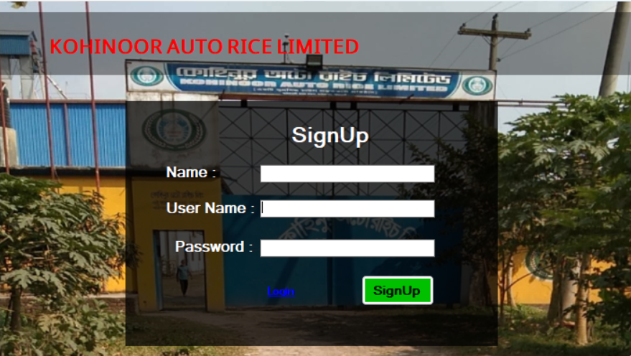
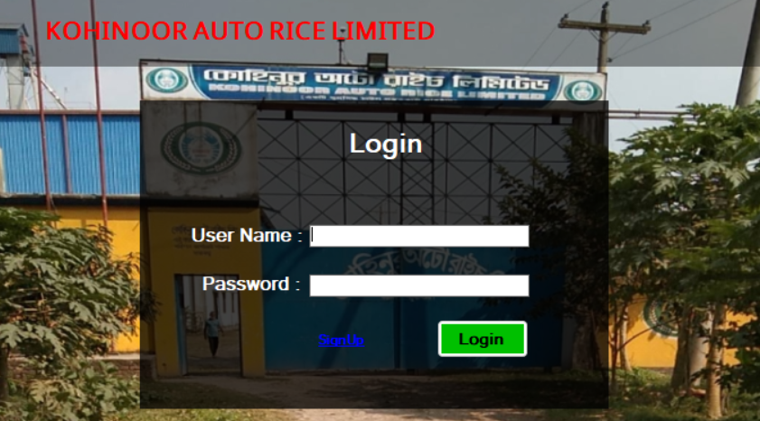
Features of Our Software
User Authentication

Slide 12
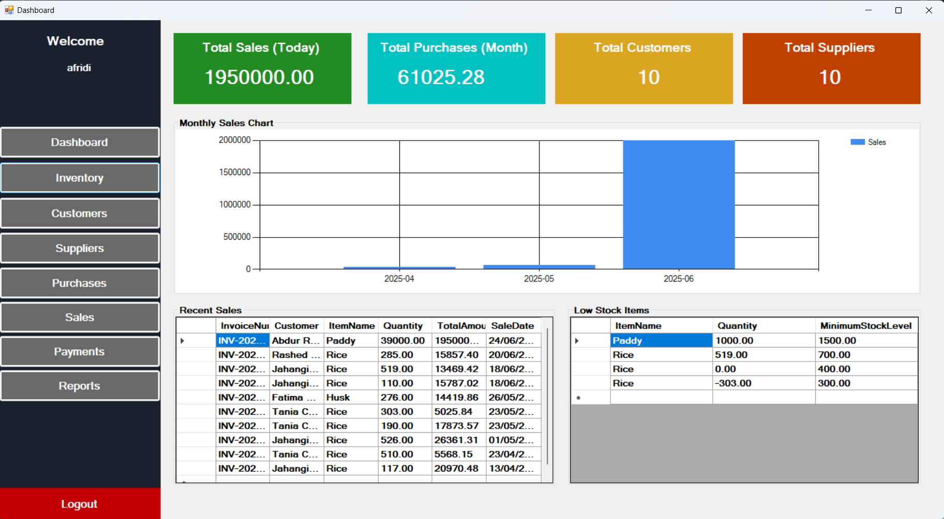
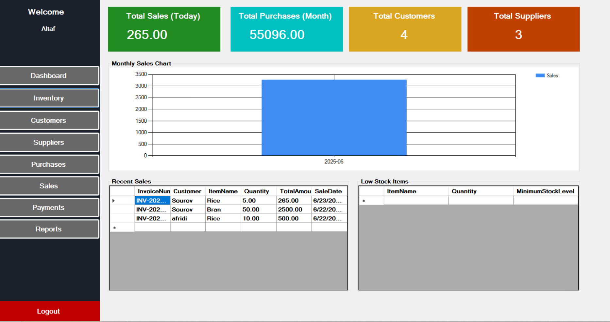
Admin Panel

Slide 13
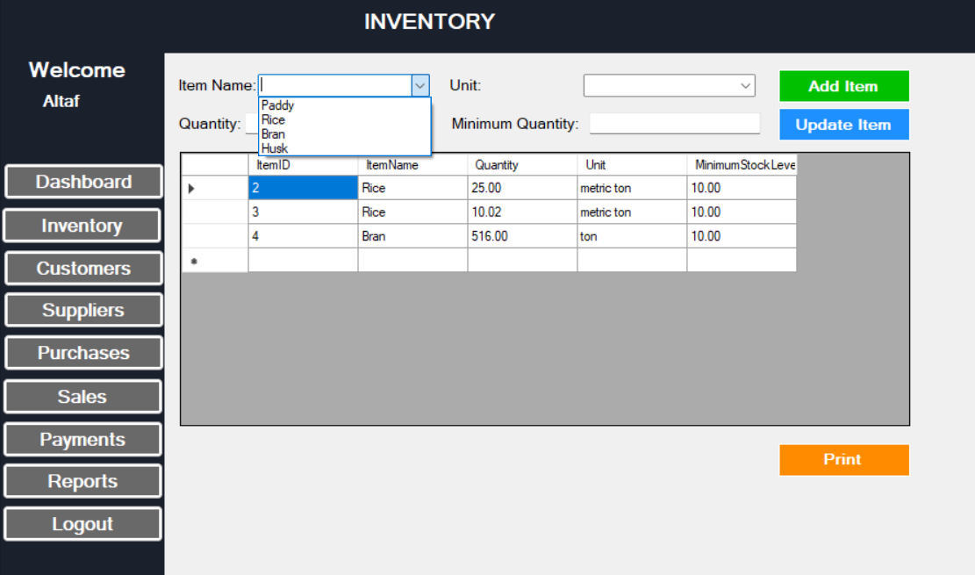

Slide 14
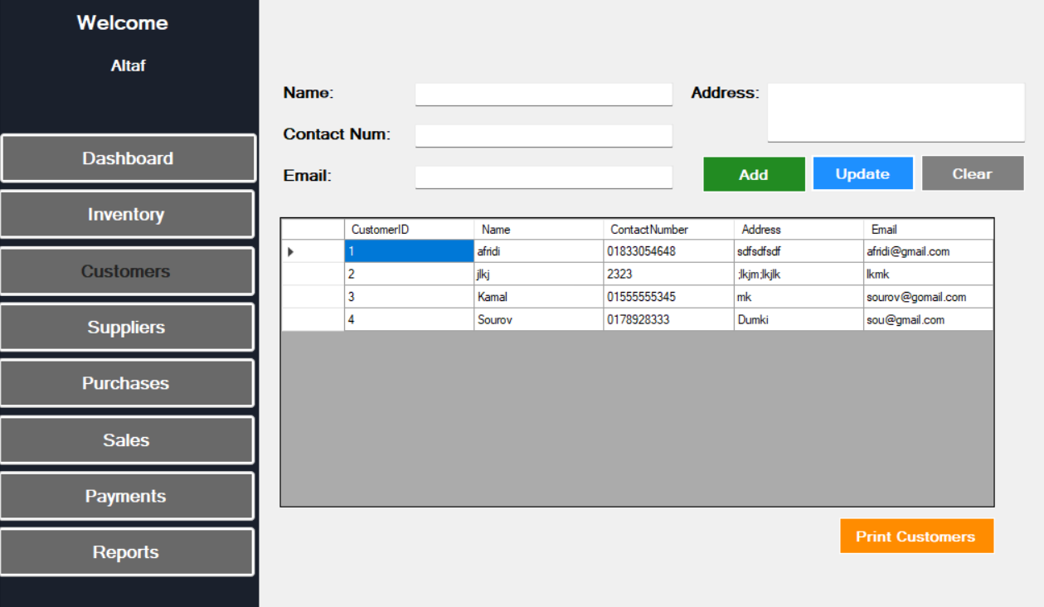
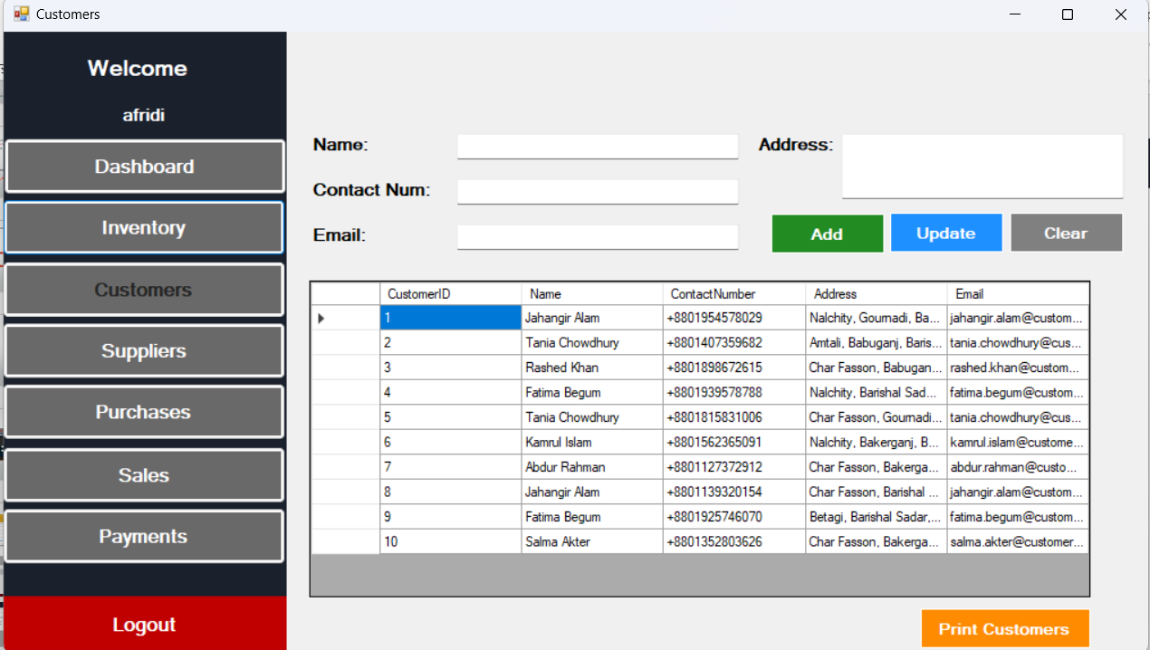

Slide 15
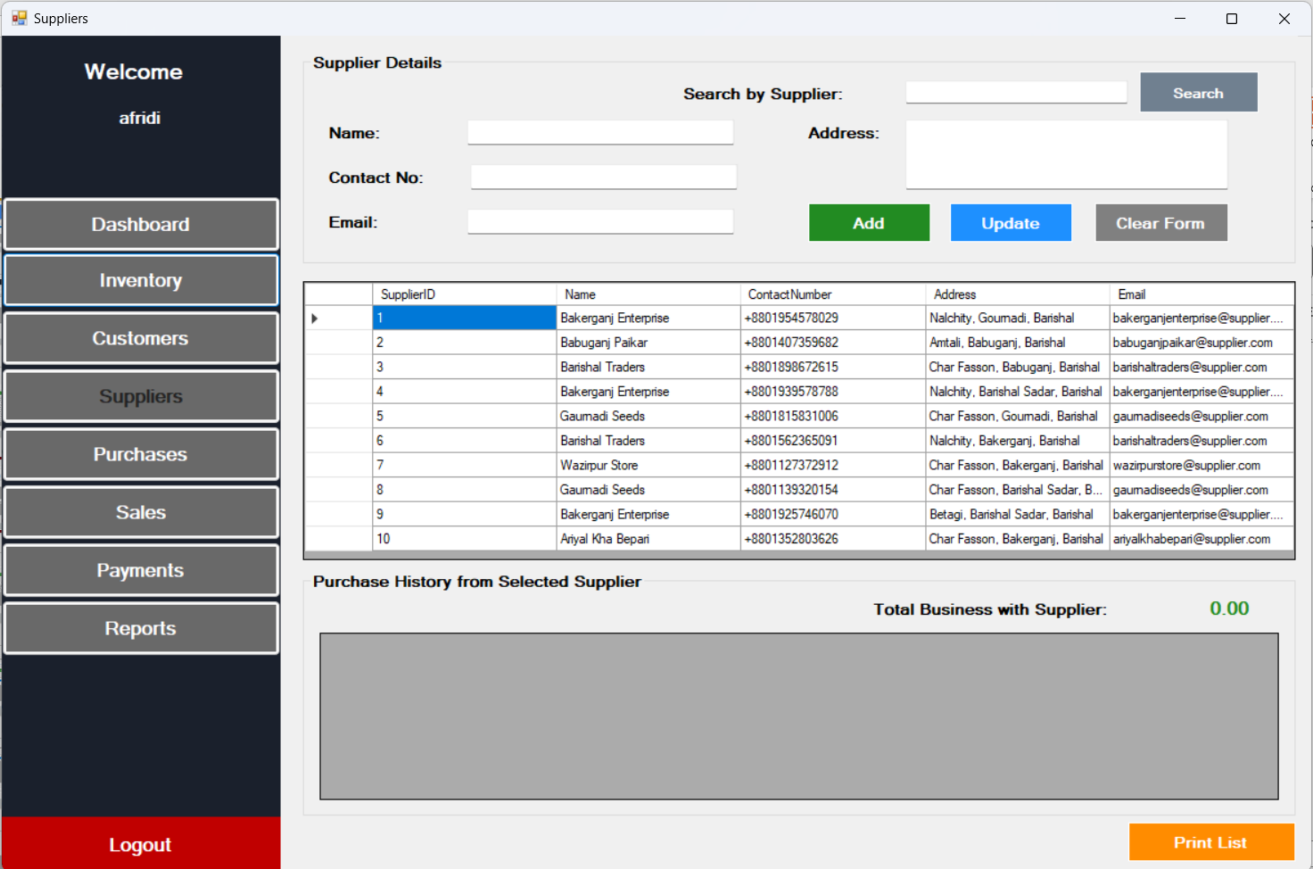
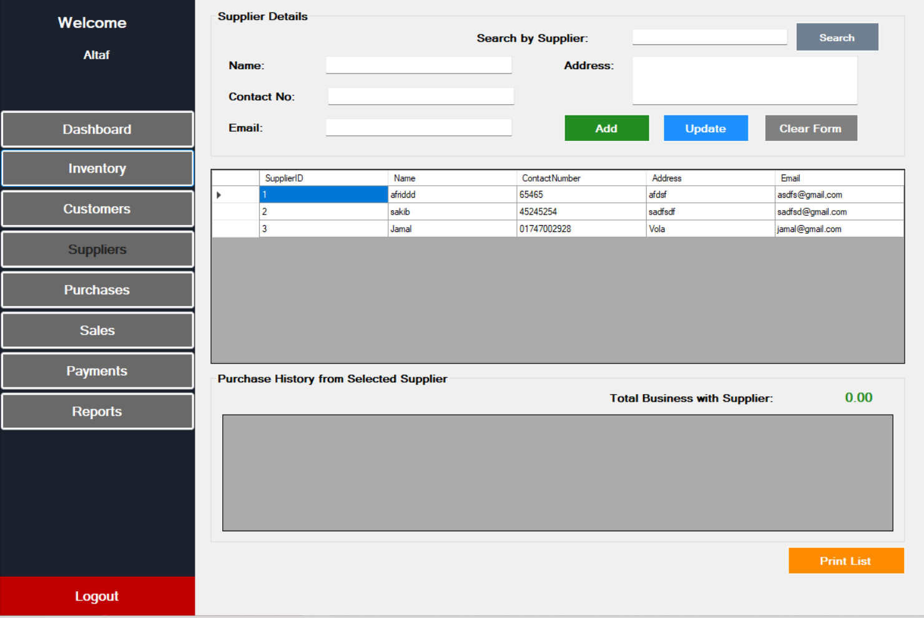

Slide 16
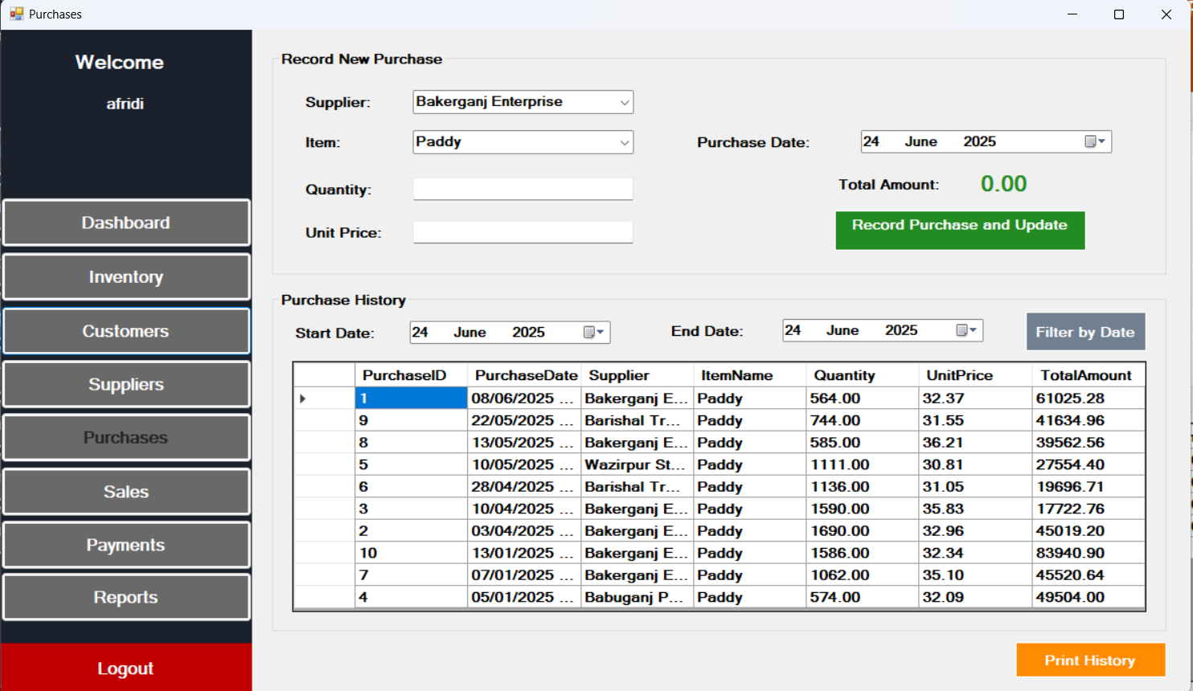
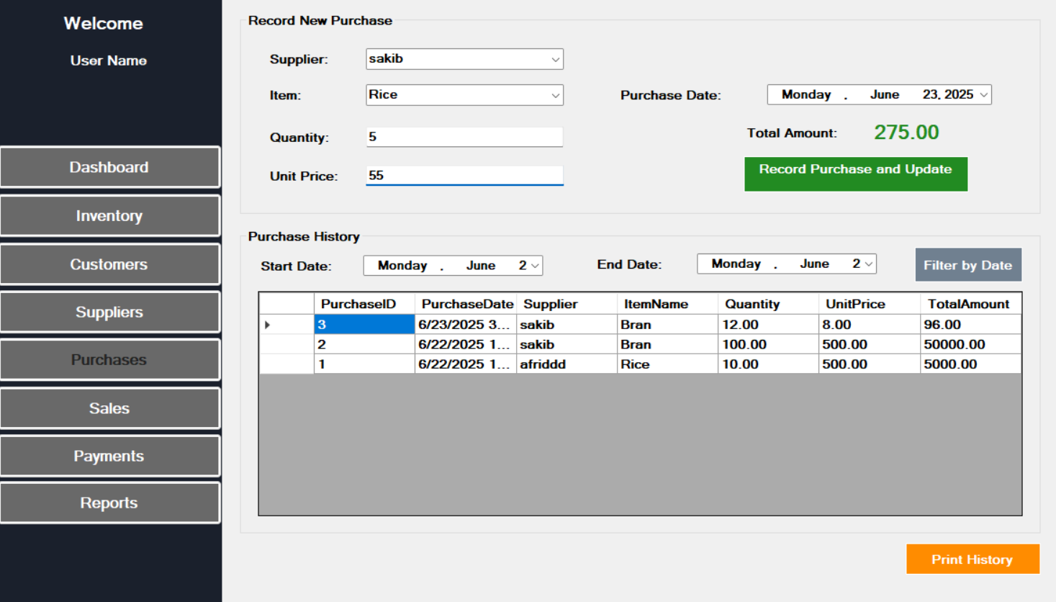

Slide 17
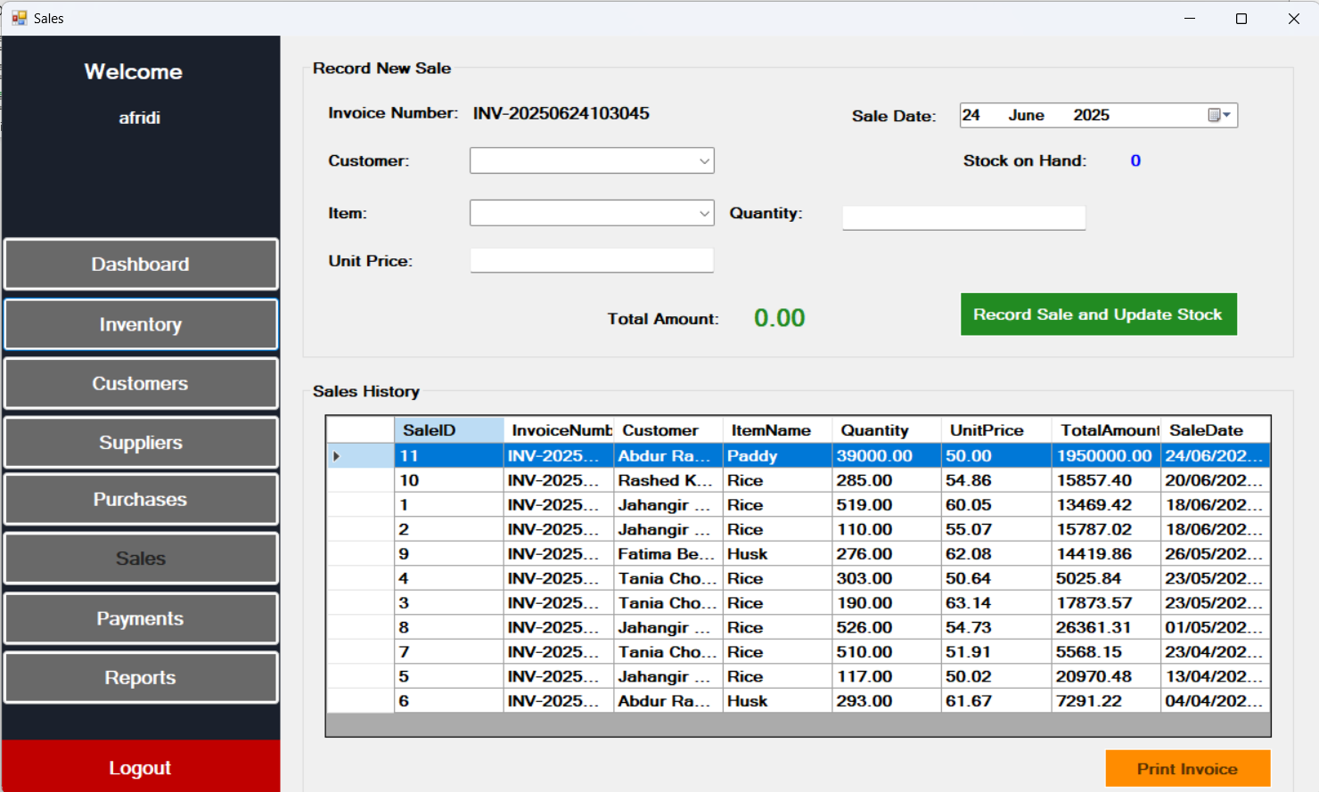
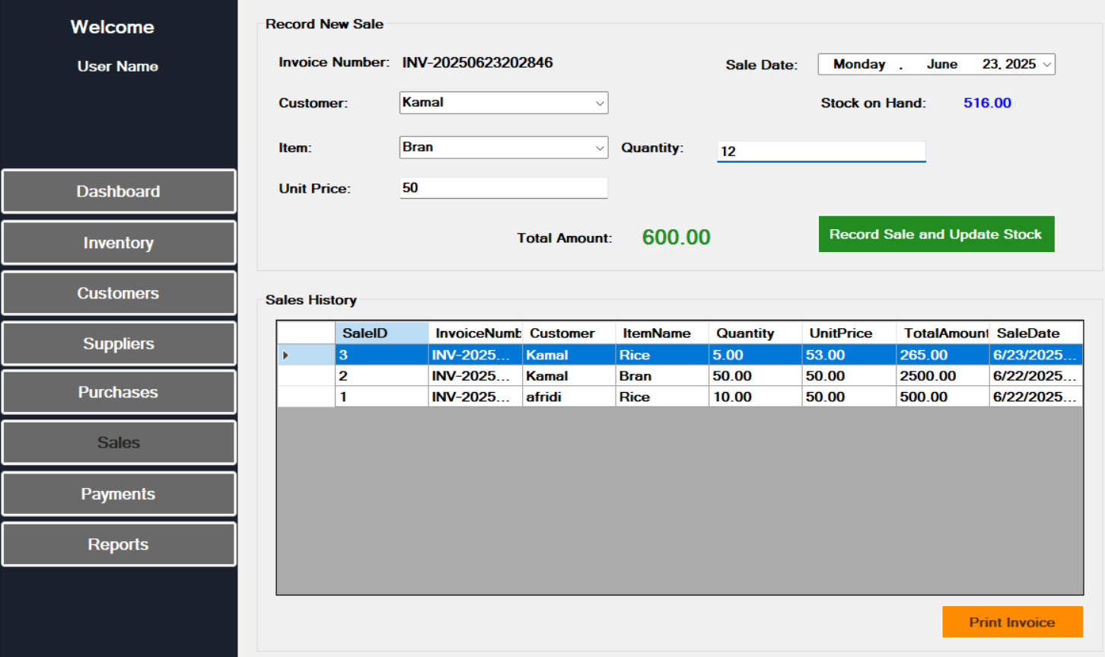

Slide 18
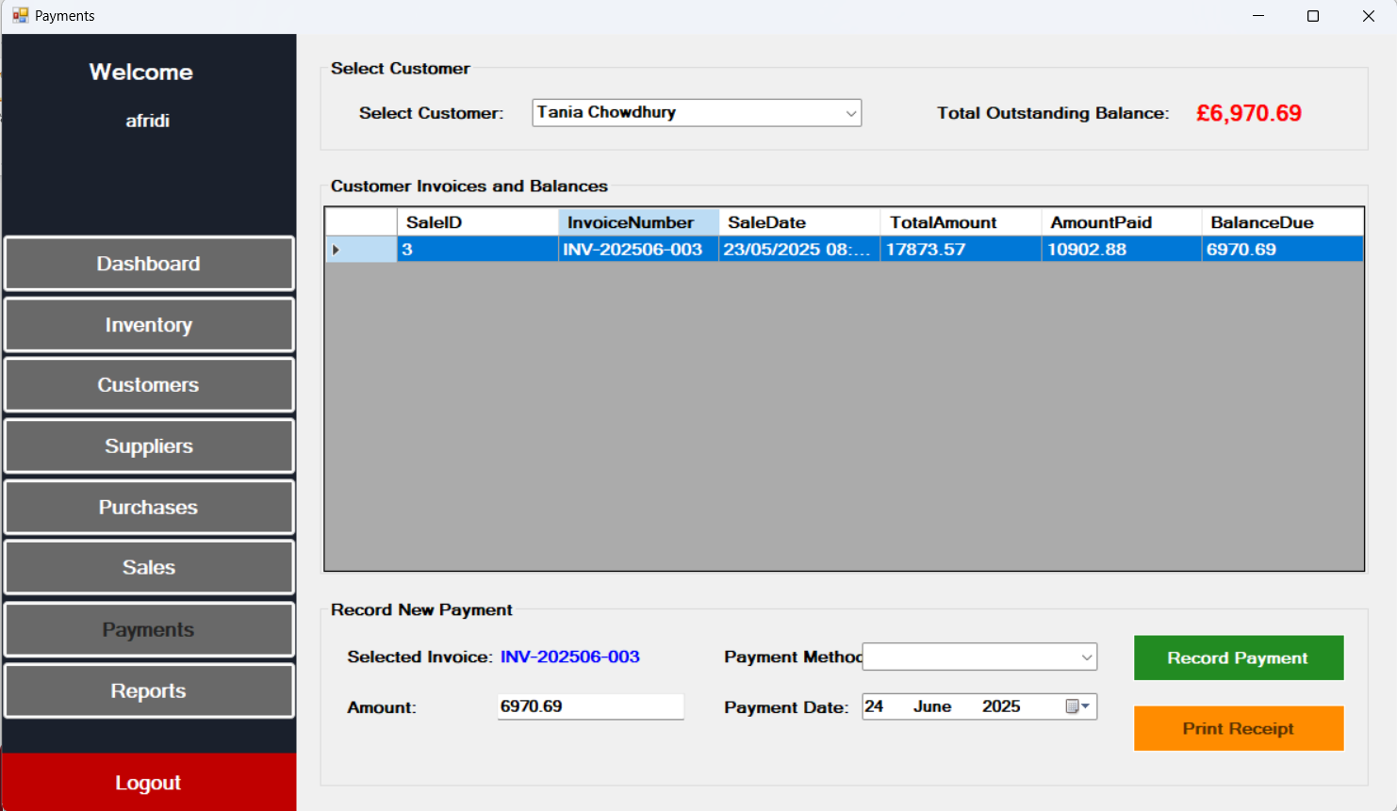
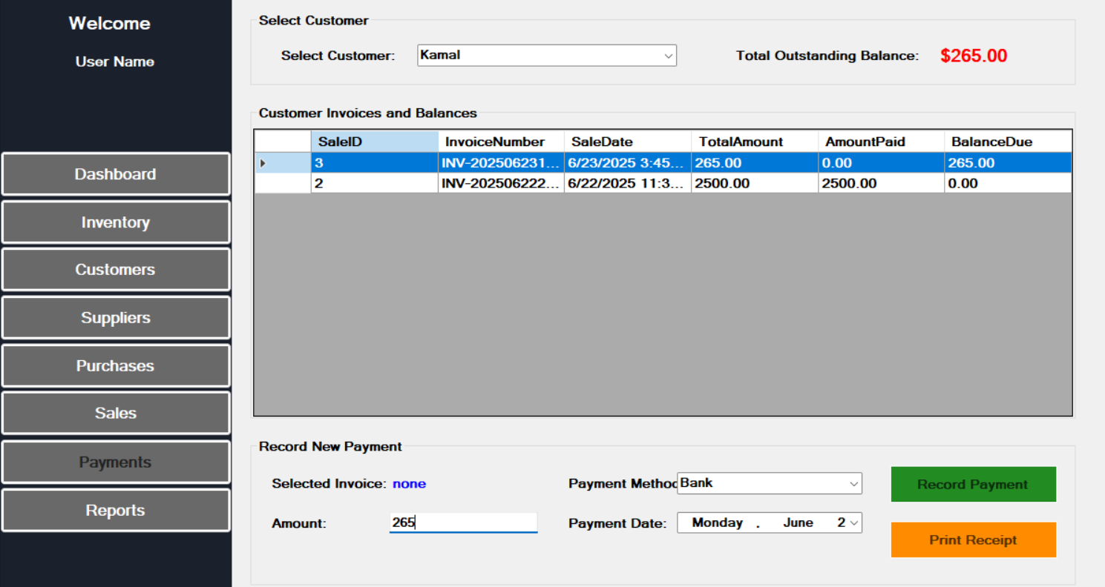

Slide 19
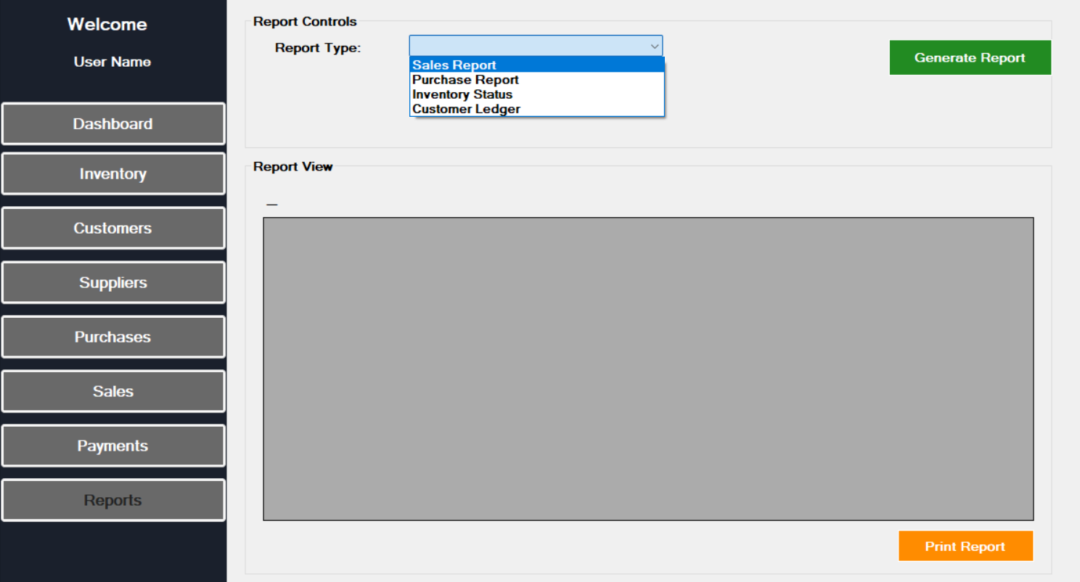

Slide 20
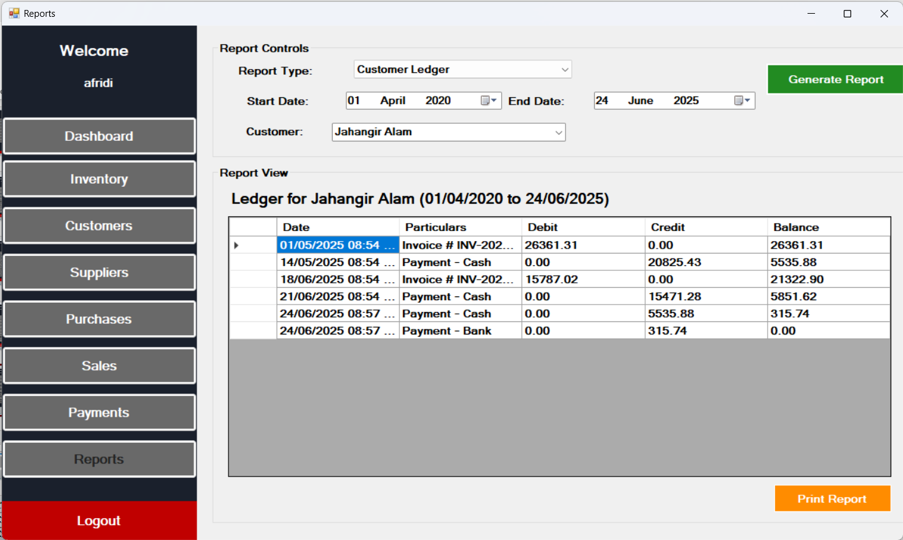
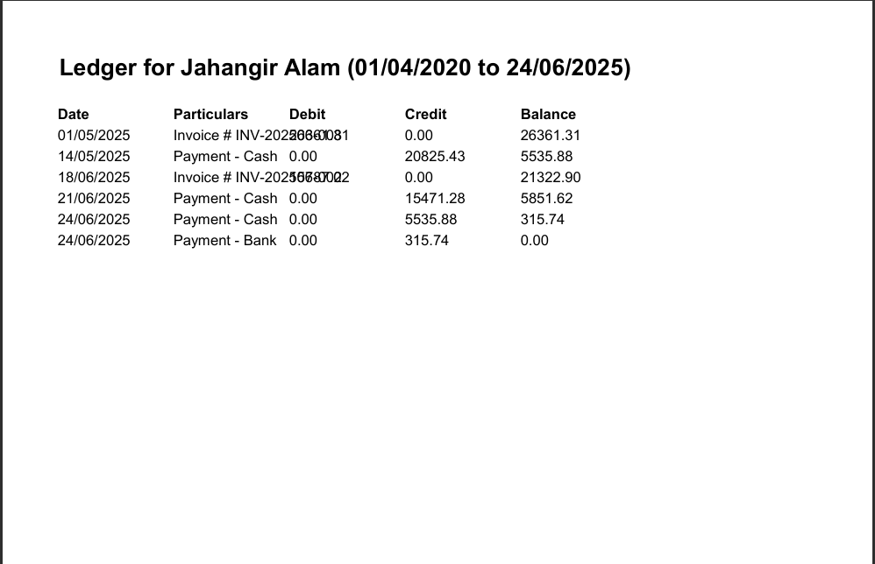
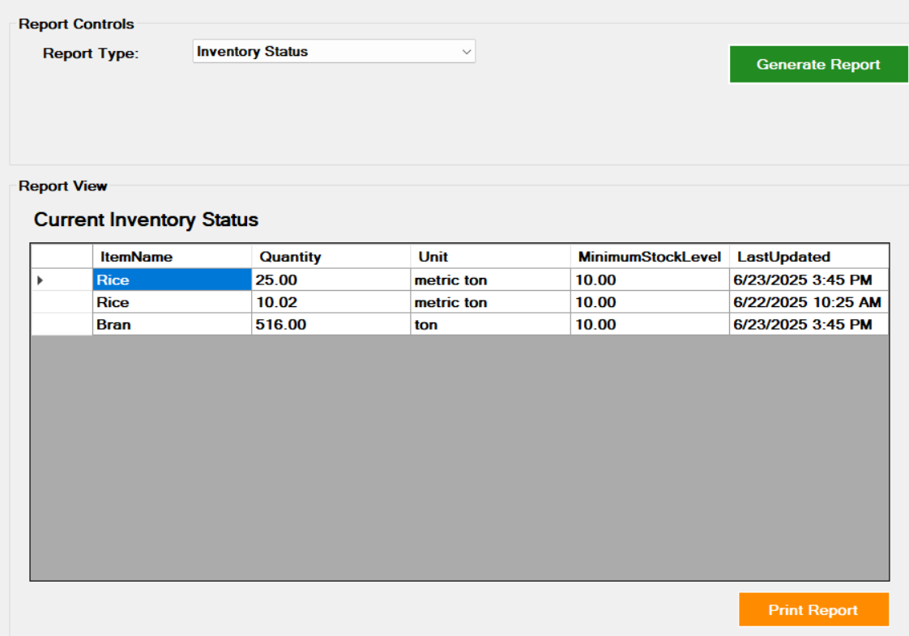

Slide 21
Outcome and Benefits
The system will bring the following benefits to Kohinoor Auto Rice Limited:
Reduced Manual Errors
Faster Decision Making
Improved Operational Visibility
Better Resource Planning
Enhanced Traceability and Accountability

Slide 22
Thank
You

